Slide 1
Dictionary challenge
Mack 2022
Notes:
Last updated: 10-31-2022

Slide 2

Crack the secret message
Starter activity
A secret message has been written below. Try to crack the code to see what the message is.
+2
RAVJQP KU CEG
Notes:
Image source: https://pixabay.com/illustrations/safe-money-dial-hand-box-secure-3703193/

Slide 3
Crack the secret message
Starter activity
A secret message has been written below. Try to crack the code to see what the message is.
PYTHON IS ACE
Notes:
Image source: https://pixabay.com/illustrations/safe-money-dial-hand-box-secure-3703193/

Slide 4

Lesson 2: Dictionary challenge
Objectives
In this lesson, you will:
Describe the dictionary data structure
Use a dictionary to produce key–value pairs

Slide 5
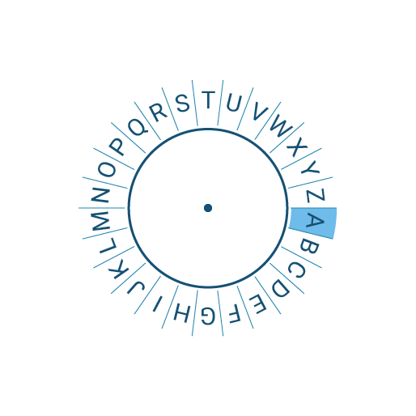
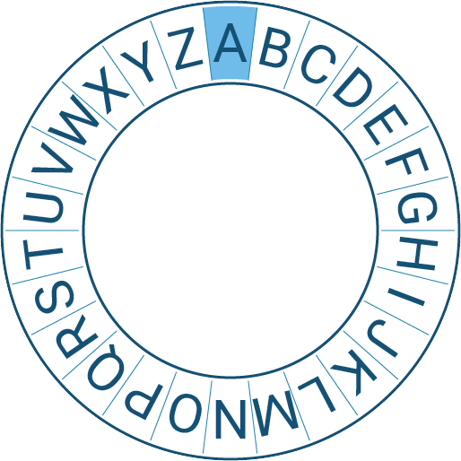

The Caesar cipher
Activity 1
A cipher is a type of secret code, where you swap the letters around so that no one can read your message.
A Caesar cipher is one of the oldest and most famous ciphers. It is named after Julius Caesar.
This makes it quite a poor choice for encryption in modern times, but it will make it a nice way to learn about cipher encryption.
Notes:
Image: from the Raspberry Pi Foundation’s Encryption online course.

Slide 6
The Caesar cipher
+2
Activity 1
A Caesar cipher uses a key. In this example, the key is +2.
This means that the inner wheel moves two letters to the right.
A key is used to lock and unlock the message. The message cannot be read without the key.
Notes:
Image: from the Raspberry Pi Foundation’s Encryption online course.

Slide 7
The Caesar cipher
+2
Activity 1
A Caesar cipher uses a key. In this example, the key is +2.
This means that the inner wheel moves two letters to the right.
Notes:
Image: from the Raspberry Pi Foundation’s Encryption online course.

Slide 8
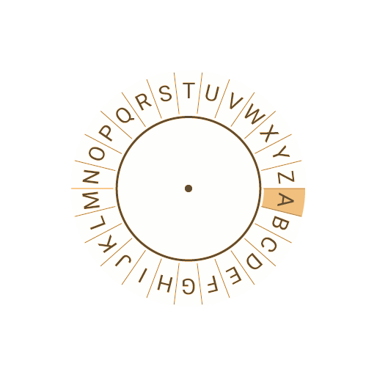
The Caesar cipher
+2
Activity 1
The inner wheel becomes the original message.
Notes:
Image: from the Raspberry Pi Foundation’s Encryption online course.

Slide 9
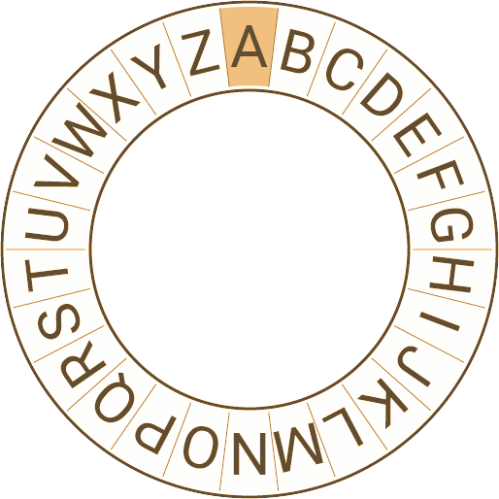
The Caesar cipher
+2
Activity 1
The outer wheel is used for the encrypted message.
Notes:
Image: from the Raspberry Pi Foundation’s Encryption online course.

Slide 10
The Caesar cipher
+2
Activity 1
To encrypt the word CAT, you start by finding C on the inner wheel and looking at the outer wheel for the encrypted letter.
C becomes E
Notes:
Image: from the Raspberry Pi Foundation’s Encryption online course.

Slide 11
The Caesar cipher
+2
Activity 1
You continue for each letter until you have finished the encryption.
C A T
E C V
Notes:
Image: from the Raspberry Pi Foundation’s Encryption online course.

Slide 12
The Caesar cipher
Activity 1
A dictionary data structure can be used to create a Caesar cipher.
This is ideal because a dictionary maps one thing to another.
Notes:
Image: from the Raspberry Pi Foundation’s Encryption online course.

Slide 13
The Caesar cipher
Activity 1
Unlike a record data structure, a dictionary data structure is dynamic.
You can change the size of the structure during execution.
This means that a dictionary can be populated during execution.
Notes:
Image: from the Raspberry Pi Foundation’s Encryption online course.

Slide 14
The Caesar cipher
Activity 1
Key–value
Pair
The key–value can hold the original character and the pair can hold the encrypted character.
Question .
What will be the output of this program when it is executed?
1 2 3 4 5 6 7 | caesar = {"Y": "A", "Z": "B", "A": "C"} encrypted = caesar["Z"] print(encrypted)
B >>>

Slide 15
The Caesar cipher
Activity 1
You can add a new key–value pairing to the dictionary using this piece of code
Question .
What will be the output of this program when it is executed?
1 2 3 4 5 6 7 | caesar = {"A": "C", "B": "D", "C": "E"} caesar["D"] = "F" print(caesar)
{'A': 'C', 'B': 'D', 'C': 'E', 'D': 'F'} >>>

Slide 16
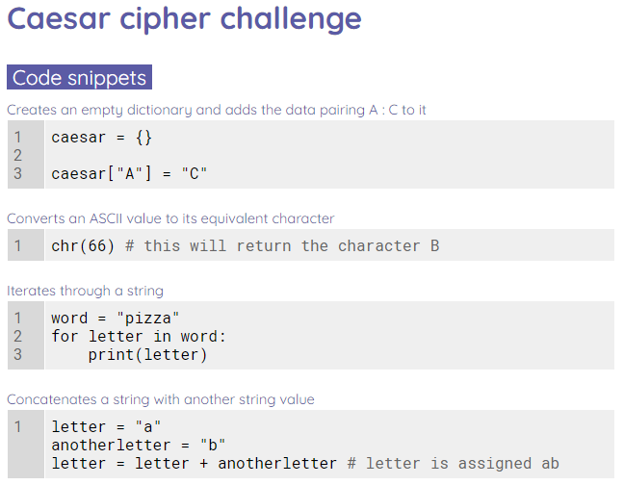
Mini project
Activity 1
This lesson you will create a Caesar cipher encryption program.
Use the worksheet to help support you with this.

Slide 17
Make a prediction
Plenary
1 2 3 4 5 6 | message = "" number = int(input()) convert = chr(number) message = message + convert print(message)
Question .
If a user enters 65 during the execution of this program, what will be the output?
65 + A
message
65
A
1
2
3
▹
4

Slide 18

Homework
Homework
Create an RPG maze game using the Raspberry Pi Projects site.
ncce.io/rpgproject

Slide 19
Next lesson
Summary
In this lesson, you…
Use a dictionary to create a Caesar cipher encryption program
Next lesson, you will…
Learn how to work with external text files

